Slide 2
‘Na, ko ngā mea katoa e pai ai koutou
kia meatia e ngā tāngata ki a koutou,
meatia hoki e koutou ki a rātou.’
‘Do to others what you would have them do to you.’
Matthew 7:12

Slide 3
How do you
Seek fairness in an unfair world?

Slide 4
Responsive Prayer for Justice
Pray for those who are hungry.
Pray harder for those who will not feed them.
Pray for those who struggle each week to pay their bills.
Pray harder for the wealthy who do not care.
Pray for those who are homeless.
Pray harder for those who deny them shelter.
Pray for the sick and lonely.
Pray harder for those who will not give them comfort.

Slide 5
Pray for those who cry out for dignity.
Pray harder for those who will not listen.
Pray for those oppressed by unjust wages.
Pray harder for those who exploit them.
Pray for those who bear the yoke of prejudice.
Pray harder for those who discriminate against them.
Pray for those whose basic needs are denied.
Pray harder for public officials who cater to the greedy
and ignore those bound unjustly.
Amen.
– United Church of Christ

Slide 6
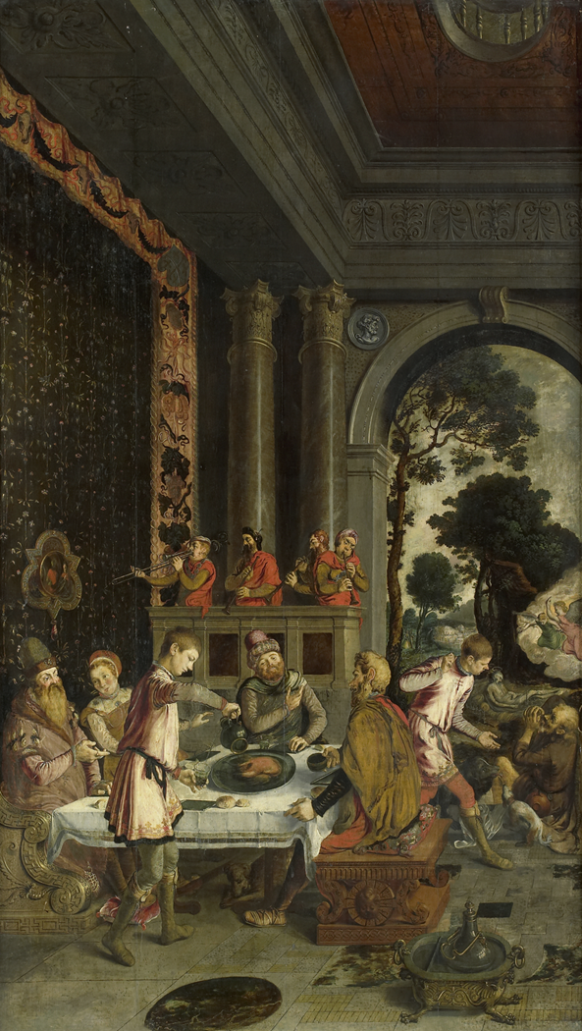
Luke 16:19-26
The Rich Man and Lazarus
Te Tangata Whai Rawa
rāua ko Raharuhi

Slide 7
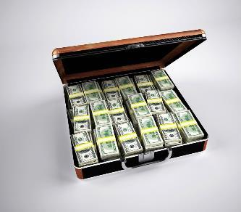
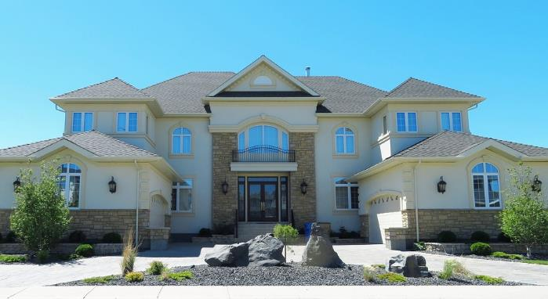
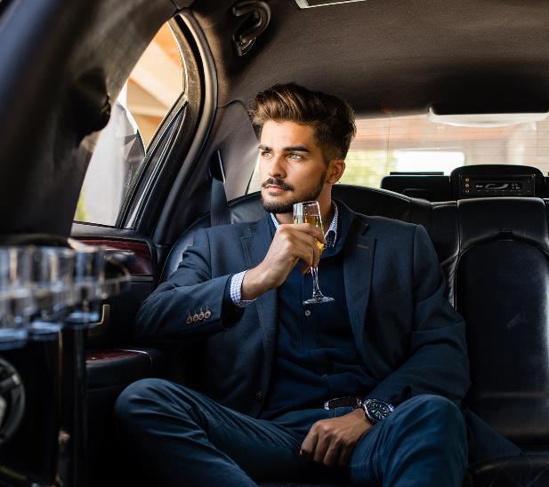
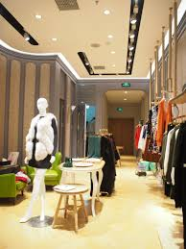
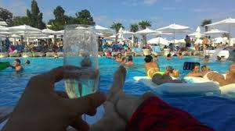
Luke 16:19-26
There was once a rich man who dressed in the most expensive clothes and lived in great luxury, every day.

Slide 8
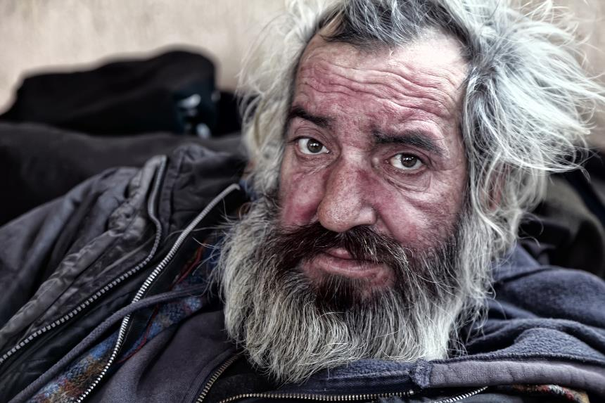
There was also a poor man named Lazarus, covered with sores, who used to be brought to the rich man’s door, hoping to eat the bits of food that fell from the rich man’s table. Even the dogs would come and lick his sores.

Slide 9
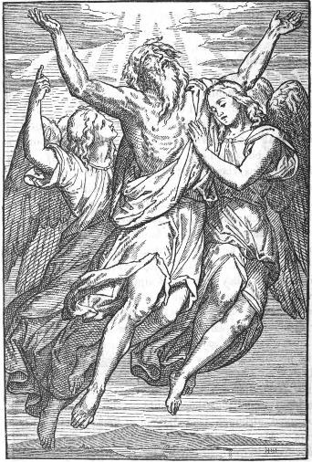
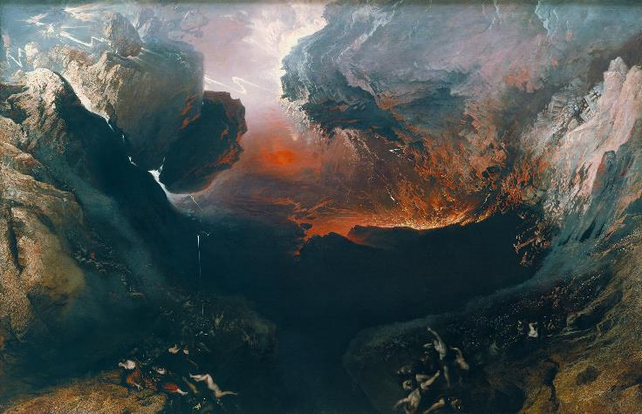
The poor man died and was carried by the angels to sit beside Abraham at the feast in heaven.
The rich man died and was buried, and in Hades, where he was in great pain, he looked up and saw Abraham, far away, with Lazarus at his side.

Slide 10
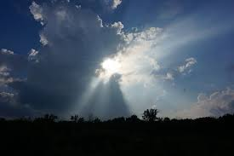
So, he called out, “Father Abraham! Take pity on me, and send Lazarus to dip his finger in some water and cool off my tongue, because I am in great pain in the fire!’ But Abraham said, ‘Remember, my son, that in your lifetime you were given all the good things, while Lazarus got all the bad things.

Slide 11
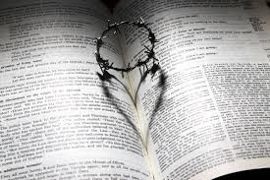
But now he is enjoying himself here, while you are in pain. Besides all that, there is a deep pit lying between us, so that those who want to cross over from here to you cannot do so, nor can anyone cross over to us from where you are.
The Word of the Lord.

Slide 12
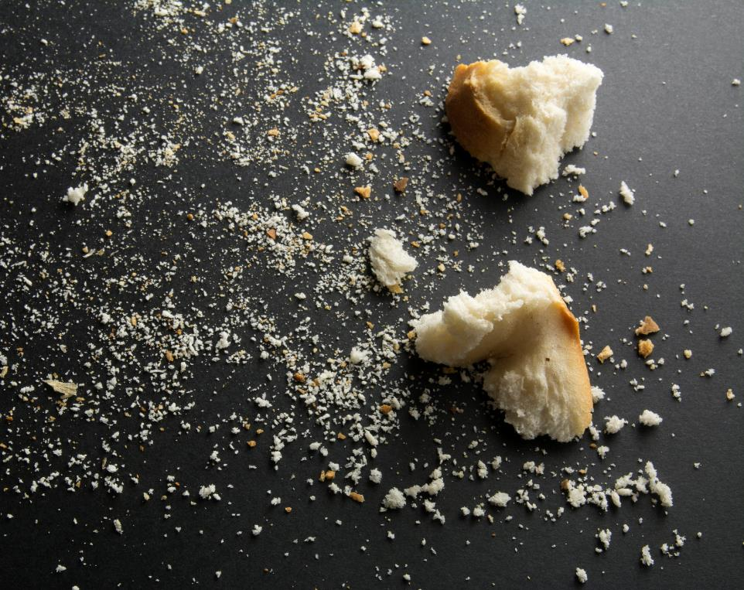
Reading Reflection
Often I have been poor and begging
for crumbs from the rich person’s table.

Slide 13
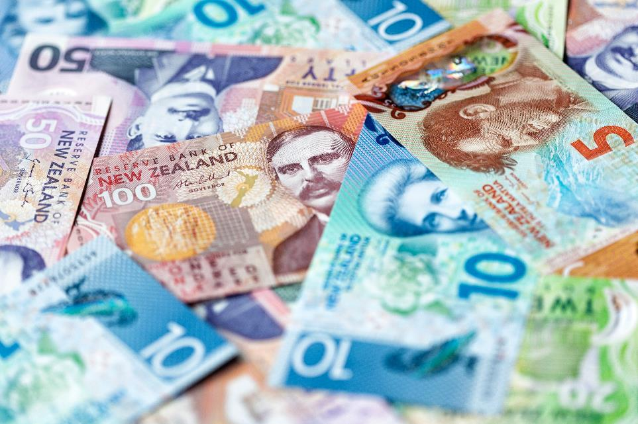
Sometimes I didn’t know I was needy
until I saw the other’s abundance
of confidence or faith, and my heart
cried out in hunger.
Notes:
Image of a school building

Slide 14
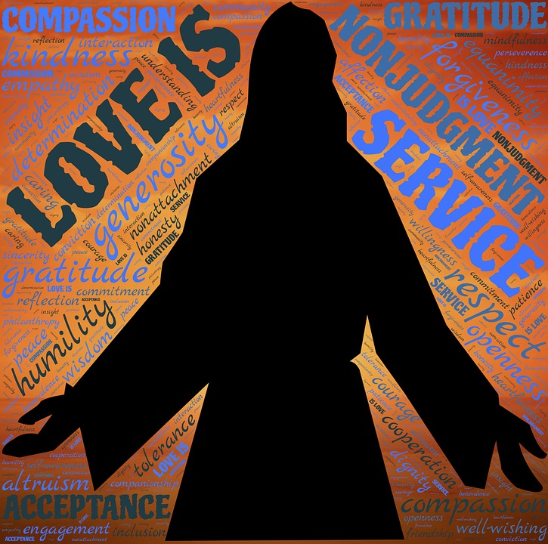
Often I have been given not mere crumbs but a great banquet of generosity.
I’ve been put in the seat of loving kindness,
the entire table open before me.

Slide 15
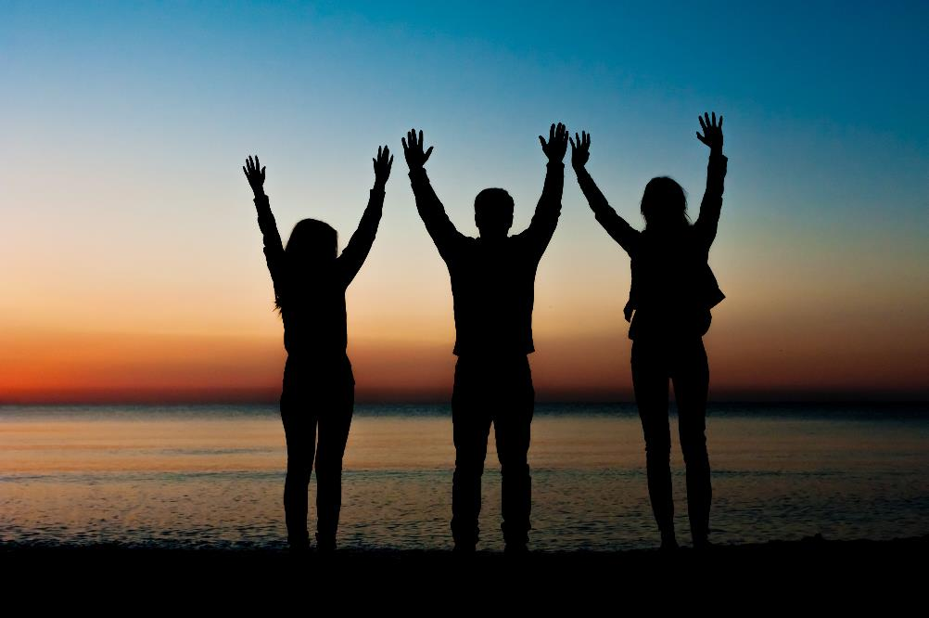
I’ve feasted on the bread of friendship,
drunk from the cup of self-esteem and seen the blossoming of my faith mirrored in the eyes of my companions.

Slide 16
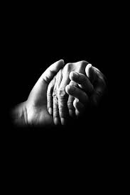
Oh God, let me not forget these moments.
On those days when my own table is rich,
may I always remember to set extra places and chairs of loving kindness for the stranger outside the gate.
Joy Cowley, Psalms Down Under

Slide 17
Who are the ‘poor’ in our community?

Slide 18
How are the ‘poor’ treated by their neighbours?

Slide 19
When you see ‘poor’, are you the Rich Man or like Lazarus?

Slide 20
How do you respond when you encounter or hear of others suffering from unfairness?
Notes:
Transition in – same as previous slide
Use the see image from the reflection sheet.

Slide 21
What do you think Jesus’ vision of fairness calls us to live like in every day life?

Slide 22
Where do you SEE unfairness
in today’s society?

Slide 23
How do you JUDGE this unfairness
caused by others?
Notes:
Need to write in the response to the prayers

Slide 24
How does Jesus call YOU to live
and ACT fairly towards others?
Notes:
Need to write in the response to the prayers

Slide 25
Prayers of the Faithful:
We pray to te Atua o te Rangimārie who in Hēhu Karaiti calls us to be makers of peace. That we be open to recognise all people as made in the image and likeness of God.
E te Atua o te Rangimārie, whakarongo mai.
All: Whakarongo ki tā mātou īnoi.

Slide 26
E te Ariki, we pray for those who enjoy the riches of this world, that they may use their resources for the common good.
E te Atua o te Rangimārie, whakarongo mai.
All: Whakarongo ki tā mātou īnoi.

Slide 27
E te Ariki, we pray that all leaders within Aotearoa use their gifts to shape us as a community steeped in fairness for all people.
E te Atua o te Rangimārie, whakarongo mai.
All: Whakarongo ki tā mātou īnoi.

Slide 28
E te Ariki, we pray that those who suffer from constant violation of human rights may be respected, recover their dignity and experience tika, pono and aroha in their everyday lives.
E te Atua o te Rangimārie, whakarongo mai.
All: Whakarongo ki tā mātou īnoi.

Slide 29
E te Ariki, we pray that all countries strive to ensure that non-violence will become the basis of conflict resolution.
E te Atua o te Rangimārie, whakarongo mai.
All: Whakarongo ki tā mātou īnoi.

Slide 30
E te Ariki, we pray that all families, communities and social agencies will work together to make all children feel secure in the knowledge that they will grow up never having to suffer from unfair treatment.
E te Atua o te Rangimārie, whakarongo mai.
All: Whakarongo ki tā mātou īnoi.

Slide 31
That the Church may be an instrument of reconciliation and peace within its own structures and communities and be a sign of peace to all.
E te Atua o te Rangimārie, whakarongo mai.
All: Whakarongo ki tā mātou īnoi.

Slide 32
Concluding Prayer
Grant us, Lord God, a vision of your world as your love would have it: a world where the weak are protected, and none go hungry or poor; a world where the riches of creation are shared,
and everyone can enjoy them; a world where different races and cultures
live in harmony and mutual respect; a world where peace is built with justice,
and justice is guided by love. Give us the inspiration and courage to build it,
through Jesus Christ our Lord.
Amen.

Slide 33
He kōanga tangata tahi,
he ngāhuru pukahu noa.
Scarce at planting,
all present at harvest.

Slide 34
www.caritas.org.nz

