Slide 2
‘Na, ko ngā mea katoa e pai ai koutou
kia meatia e ngā tāngata ki a koutou,
meatia hoki e koutou ki a rātou.’
‘Do to others what you would have them do to you.’
Matthew 7:12

Slide 3
How do you
Seek fairness in an unfair world?

Slide 4
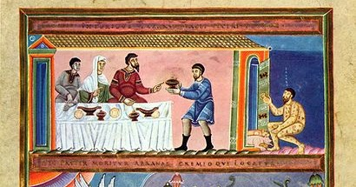
Reading: Luke 16:19-26
The Rich Man and Lazarus
Te Tangata Whai Rawa rāua ko Raharuhi
A modern adaptation created for New Zealand schools

Slide 5
This is Phil.
This is Michael.

Slide 6
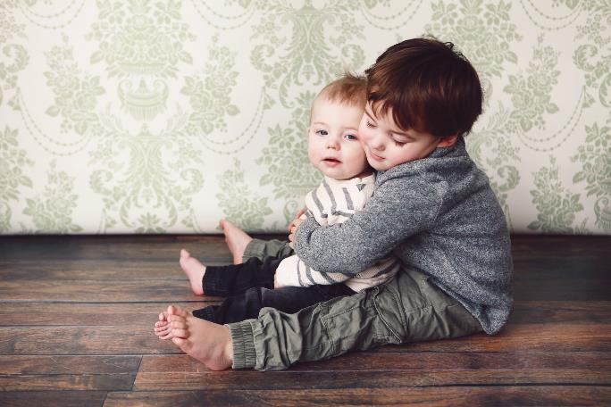
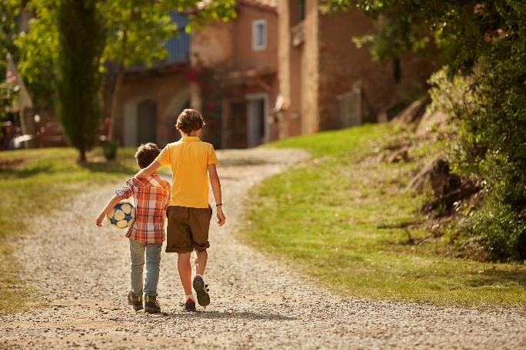
They are brothers.

Slide 7
Phil is in Year 4.
He follows all the school rules and expectations.

Slide 8
Michael is in Year 7.
He doesn’t follow any school rules or expectations.

Slide 9
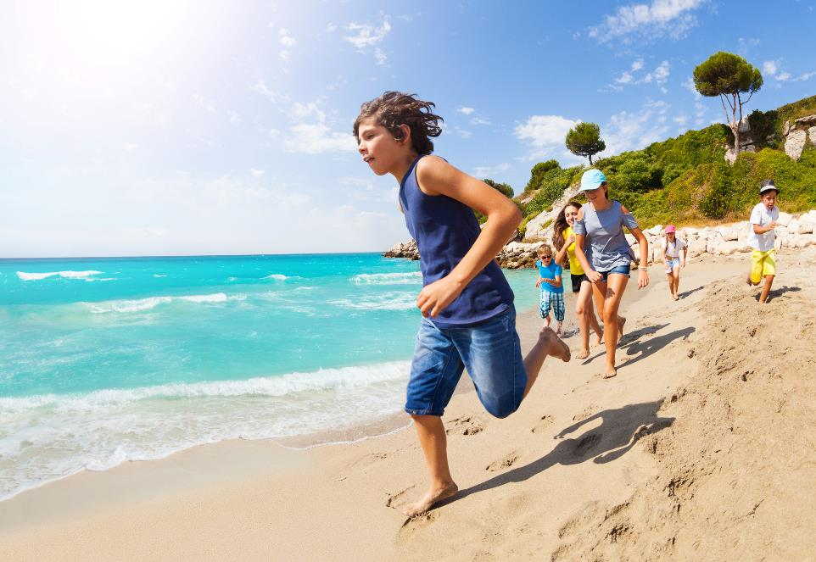
Michael is
extremely
popular.
He has heaps and heaps of friends.

Slide 10
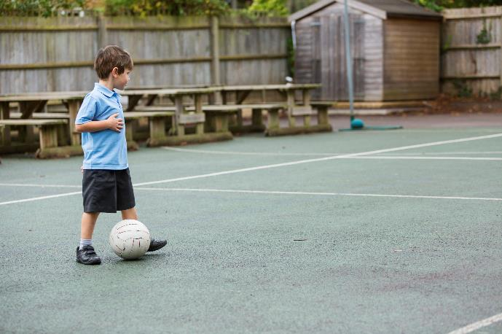
Phil is not very popular and he doesn’t have any friends.
(Some people call him a social outcast.)

Slide 11
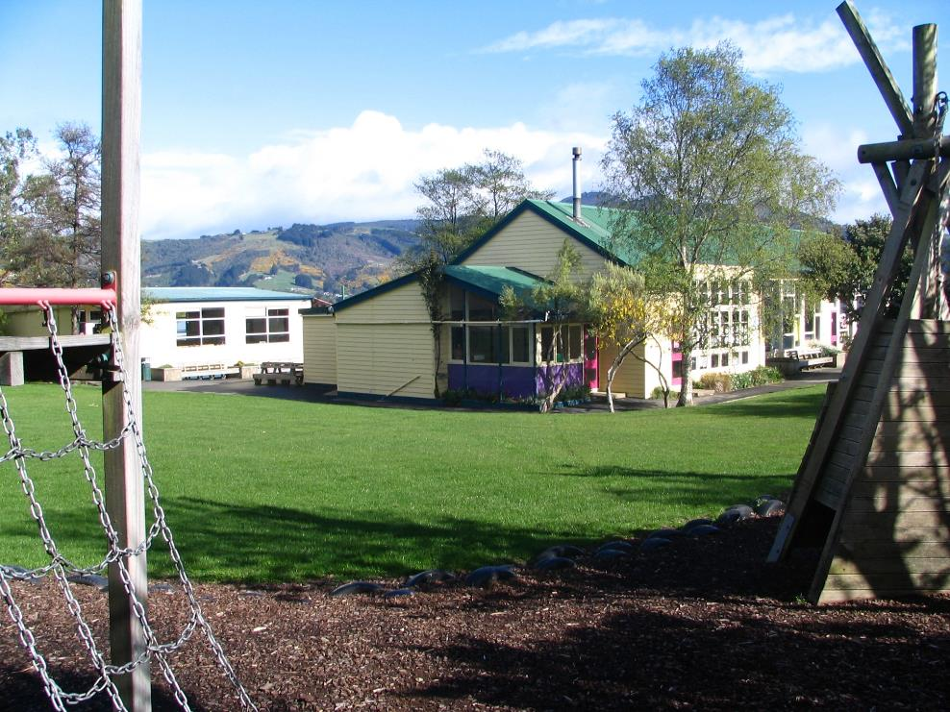
They
attend the
same school.

Slide 12
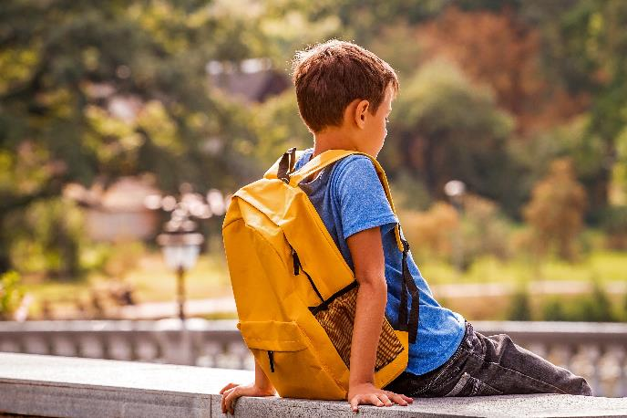
At break times,
Phil has no-one to play or eat with.

Slide 13
Every day,
Phil asks Michael to help him find a friend, or if he could sit with him at lunchtime.

Slide 14
And every day …
Michael refuses to help his little brother and ignores him.

Slide 15
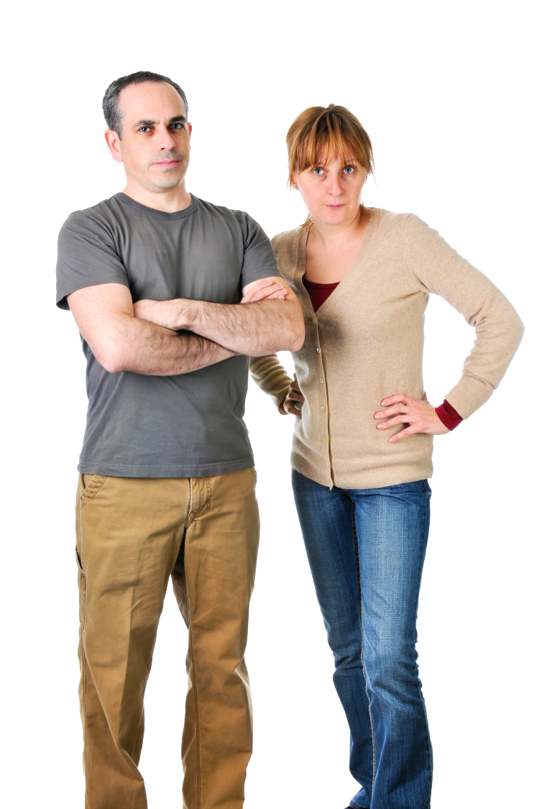
The boys’ parents become aware of what is happening at school and are disappointed with Michael’s behaviour.

Slide 16
Michael’s parents tell him off for how he has been treating his brother.
They tell him to pay more attention to his brother and help him find friends.

Slide 17
The next day …
Michael refuses to help Phil again
or to sit with him.

Slide 18
So…
Some of Michael’s friends see what is happening to Phil, and they decide to help him find some friends to eat with.

Slide 19
When Michael gets home, his parents had already heard about what had happened at school.
They thought Michael knew how to treat people better than that …
…especially his brother.

Slide 20
Michael is punished quite harshly for his behaviour towards Phil.
Michael’s parents had warned him, repeatedly, about his behaviour and the consequences.

Slide 21
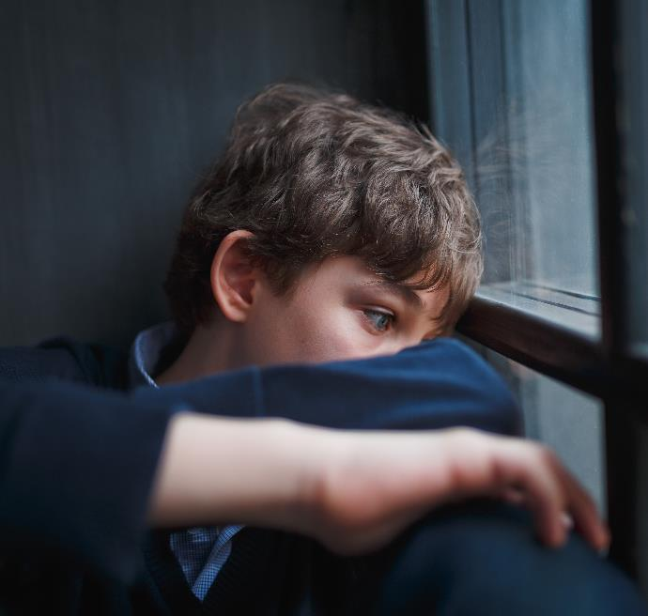
Michael begins to feel bad about how he has treated his brother. He goes and talks to his parents about how he feels.

Slide 22
Phil is a lot happier at school, and loves hanging out with his new friends.

Slide 23
Who were the poor in the story
about Michael and Phil? Why?

Slide 24
Who are the poor in our community?

Slide 25
How do we treat the ‘poor’?

Slide 26
Who are you like?
The Rich Man (Michael)
Lazarus
(Phil)
OR

Slide 27
Where do you SEE unfairness?

Slide 28
How do you JUDGE unfairness?

Slide 29
How does Jesus call us
to live and ACT fairly?

Slide 30
PRAYERS OF THE FAITHFUL:
We pray to te Atua o te Rangimārie who in Hēhu Karaiti calls us to be makers of fairness.
Our response is:
Whakarongo ki tā mātou īnoi.

Slide 31
E te Ariki, we pray for those who enjoy the riches of this world, that they may use their resources for the common good.
E te Atua o te Rangimārie, whakarongo mai.
All: Whakarongo ki tā mātou īnoi.

Slide 32
E te Ariki, we pray that all leaders within Aotearoa use their gifts to shape us as a community steeped in fairness for all people.
E te Atua o te Rangimārie, whakarongo mai.
All: Whakarongo ki tā mātou īnoi.

Slide 33
E te Ariki, we pray for those who suffer from unfairness to be treated with respect and experience tika, pono and aroha in their everyday lives.
E te Atua o te Rangimārie, whakarongo mai.
All: Whakarongo ki tā mātou īnoi.

Slide 34
E te Ariki, we pray that all countries around the world work towards ensuring that fairness and justice will become the basis of conflict resolution.
E te Atua o te Rangimārie, whakarongo mai.
All: Whakarongo ki tā mātou īnoi.

Slide 35
E te Ariki, we pray that we will work together so that all who face unfairness, will feel secure in the knowledge that they will be treated fairly in a world striving for fairness.
E te Atua o te Rangimārie, whakarongo mai.
All: Whakarongo ki tā mātou īnoi.

Slide 36
E te Ariki, we pray that te Whānau o te Karaiti may be an instrument of reconciliation and peace within its own structures and communities and be a sign of fairness to all.
E te Atua o te Rangimārie, whakarongo mai.
All: Whakarongo ki tā mātou īnoi.

Slide 37
Prayer for Fairness
Grant us, Lord God,
a vision of your world
as your love would have it:
A world where those treated unfairly
are protected, and don’t go hungry or poor;
A world where the riches of creation
are shared, and everyone can enjoy them;

Slide 38
A world where different races and cultures
live in harmony and mutual respect; A world where peace is encouraged
through fairness, and guided by love.
Give us the inspiration and courage to build it, through Jesus Christ our Lord.
Amen.
Adapted from Author Unknown

Slide 39
He kōanga tangata tahi,
he ngāhuru pukahu noa.
Scarce at planting,
all present at harvest.

Slide 40
www.caritas.org.nz

