Slide 3
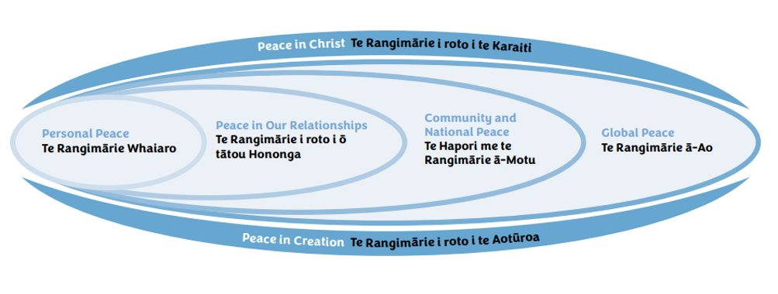
CIRCLES OF PEACE
Peace operates on many levels.
It begins with building personal peace through the peace of Christ!

Slide 10
Prayer for Peace, Pope St. John Paul II
Lord Jesus Christ, who are called the Prince of Peace, who are Yourself our peace and reconciliation, who so often said, “Peace to you” – please grant us peace.
Make all men and women witnesses of truth, justice, and brotherly love. Banish from their hearts whatever might endanger peace. Enlighten our rulers that they may guarantee and defend the great gift of peace.
May all peoples on the earth become as brothers and sisters.
May longed-for peace blossom forth and reign always over us all.
Amen.

